Slide 1
Nakuja internship Avionics progress report Batch 2 week 8
PRESENTED BY: Muchiri ian ngethe

Slide 2
Tasks completed this week
Avionics bay fabrication
PCB decoupling and redesign
PCB etching and drilling
Avionics PCB assembly
Avionics bay assembly
Test flight
Issue #157 : RTOS optimization
● Issue #158 : Ground Station Parachute Manual override
● Issue #159 : Write telemetry data to flash memory during flight

Slide 3
1. PCB decoupling and redesign
Due to the limitations of single layer PCB fabrication, we had to decouple the single PCB into four different PCB inorder to be able to carry put single layer etching

Slide 4
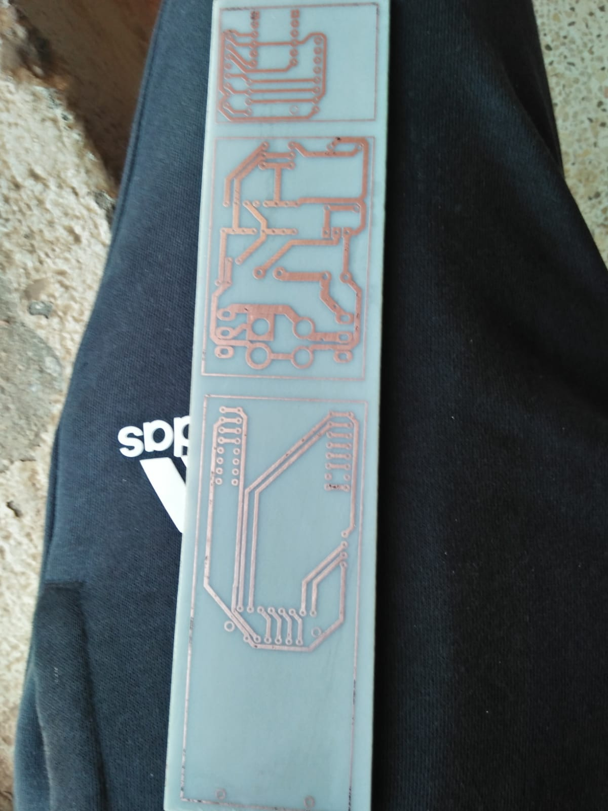
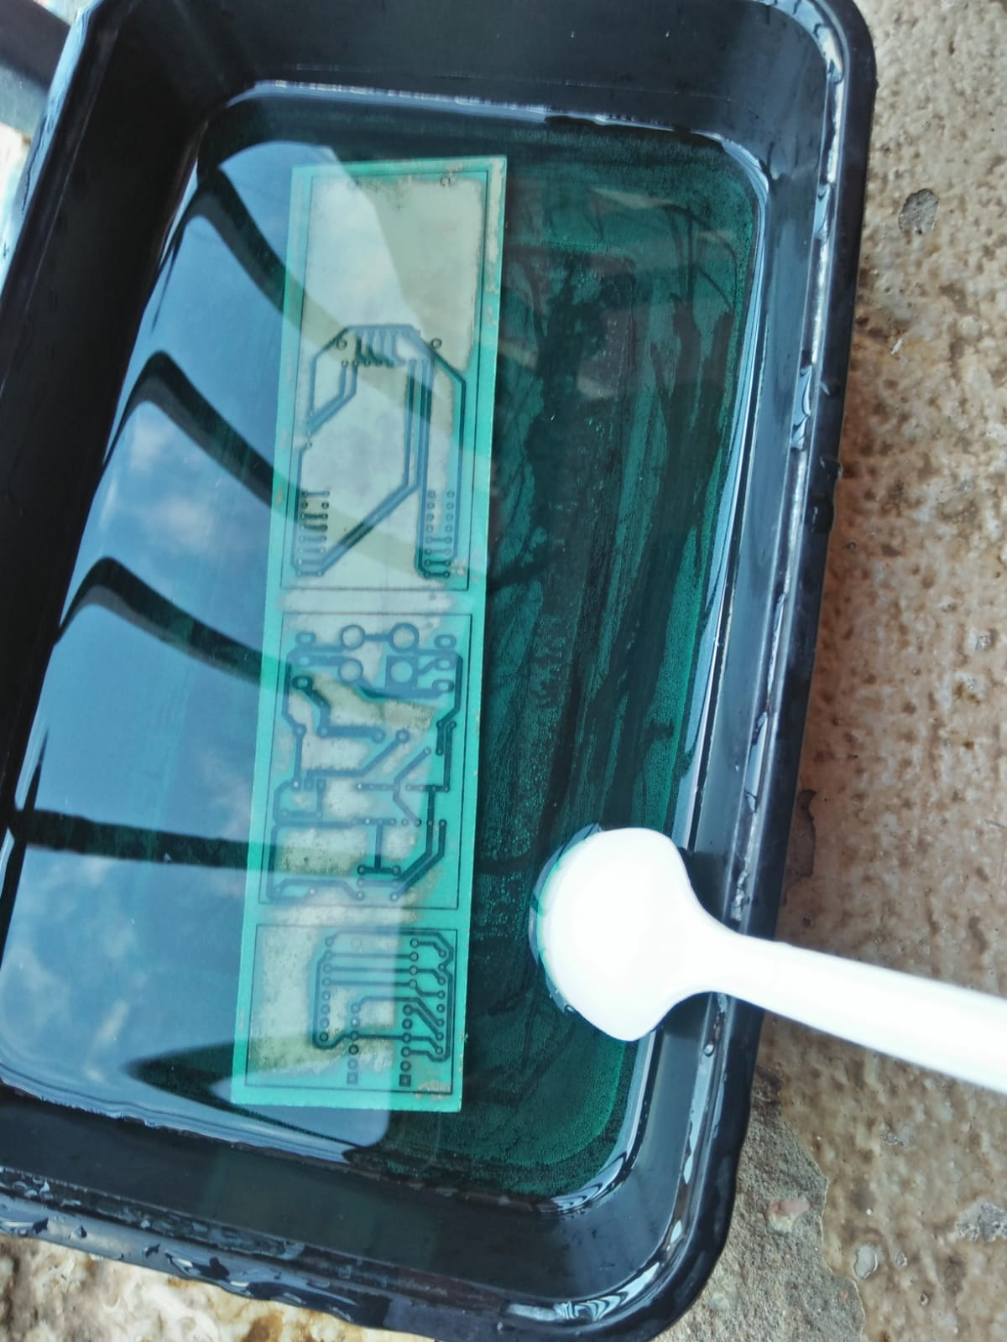
PCB etching and drilling
We were able to etch the PCB’s and drill holes for mounting the components

Slide 5
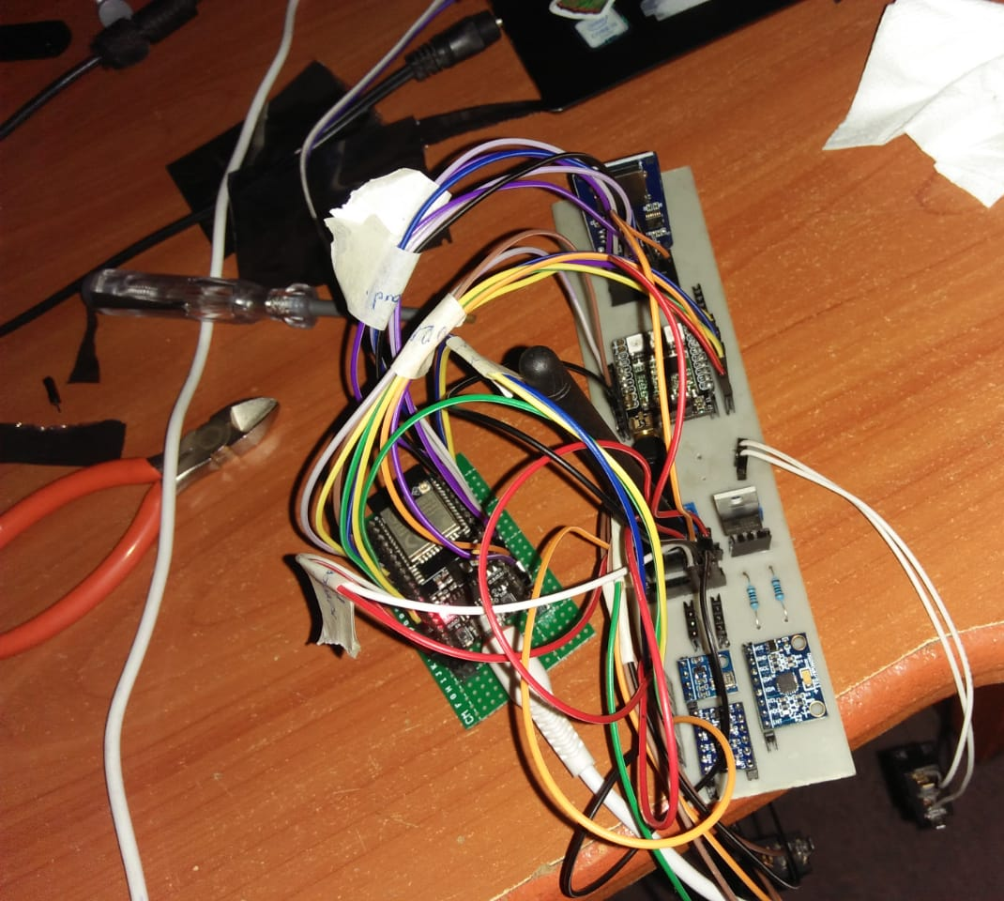
AVIONICS Pcb component assembly
The components were successfully mounted and a continuity test was carried out.

Slide 6
AVIONICS BAY FABRICATION AND ASSEMBLY
The avionics bay was fabricated from the PVC tube used in fabricating the fiberglass airframe of the rocket.
The various subsections of the avionics bay were separated using wooden blocks and the various components were assembled.

Slide 7
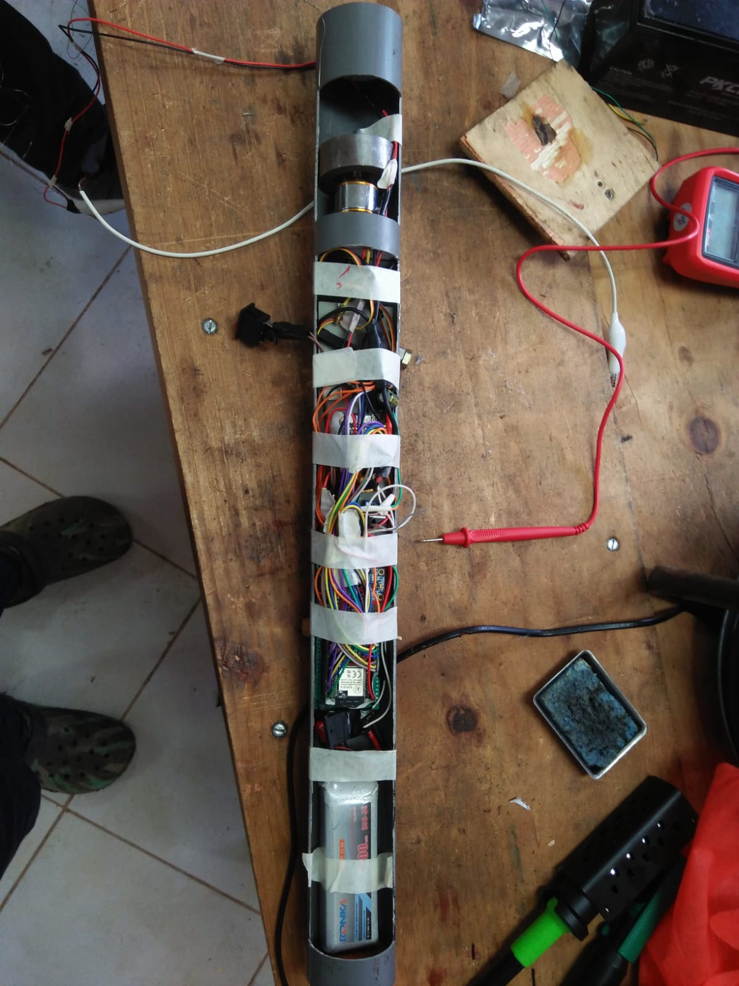
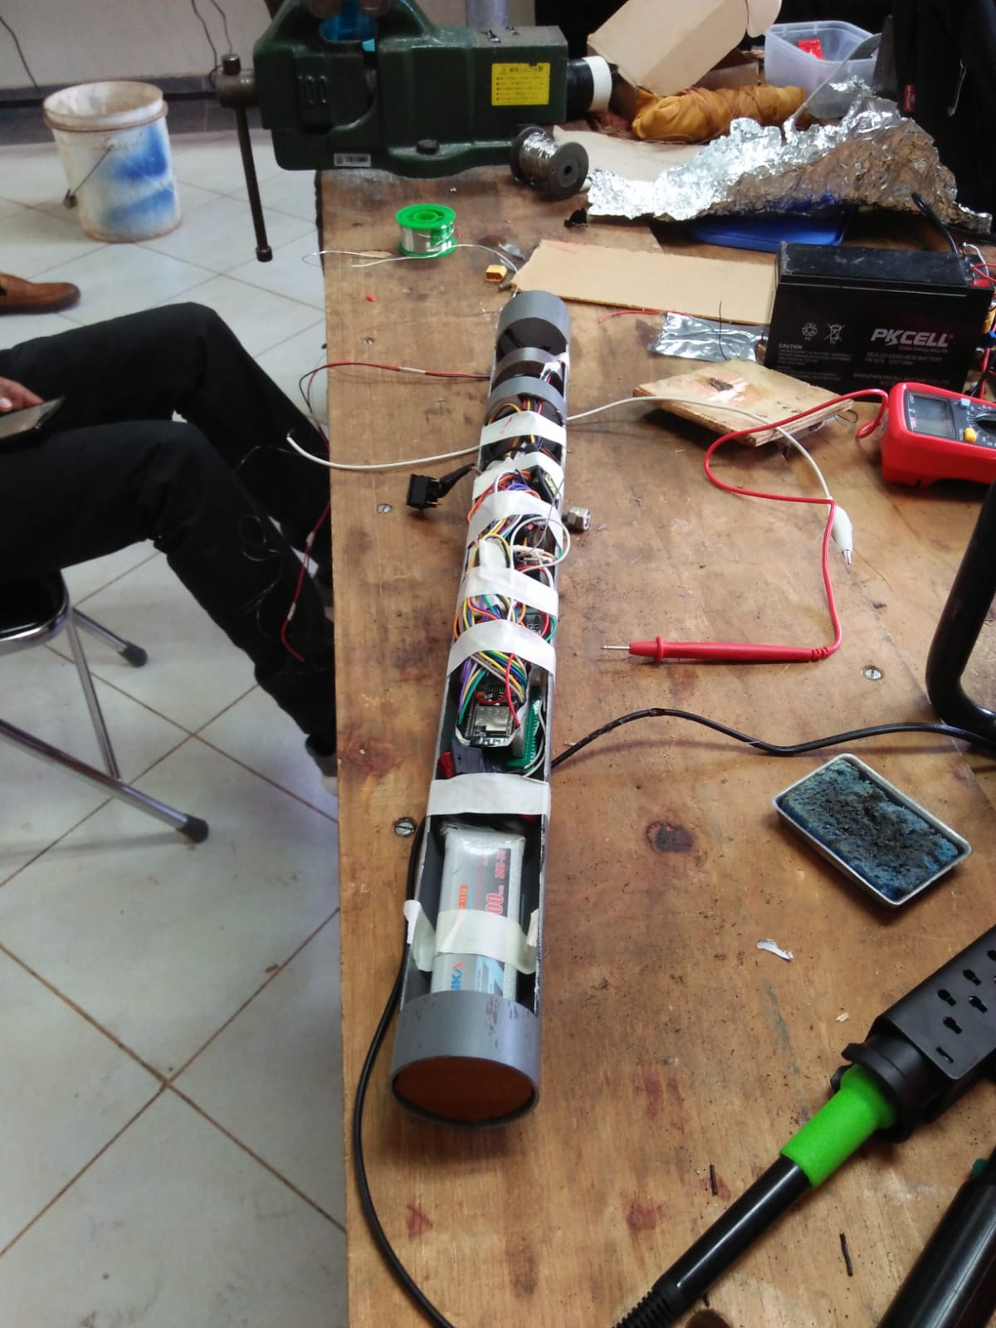

Slide 8
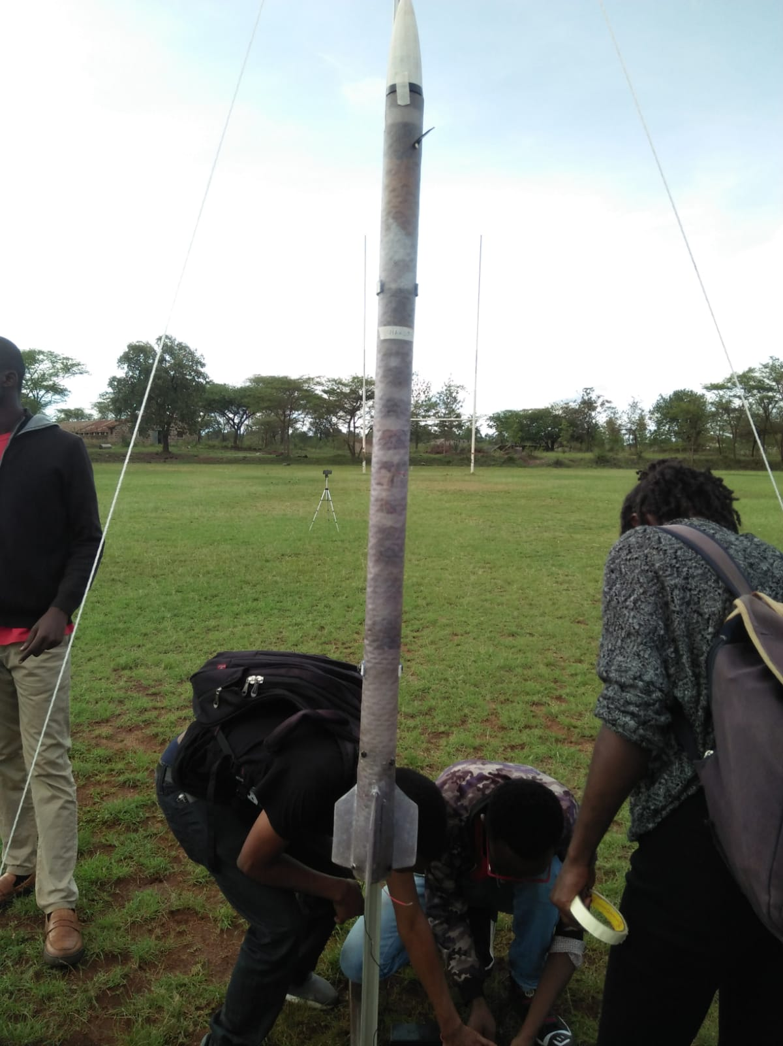

TEST FLIGHT
The avionics bay was mounted on the rocket at the launch pad and the ejection section and parachute we finally mounted.

Slide 9
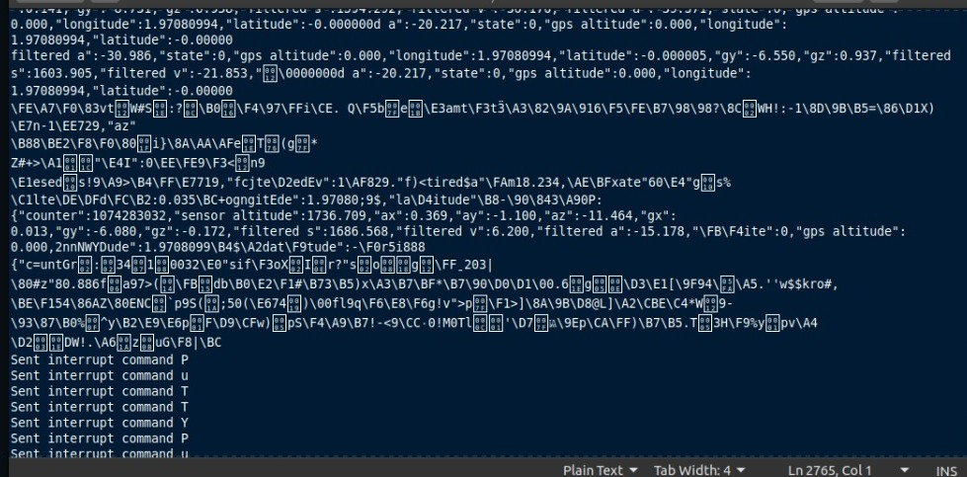
During the test flight we were able to transmit data via LoRa. Some of the data was corrupted but we were able to plot the altitude, velocity and acceleration of the rocket.

Slide 10
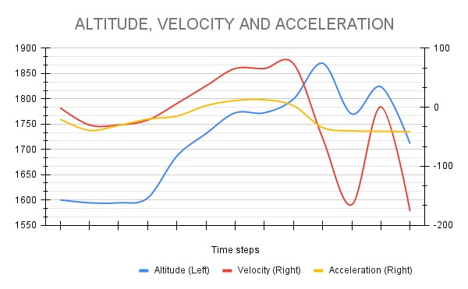

Slide 11
Post flight analysis
SUCCESSES:
There was data transmission
Working of the BMP and MPU sensors
Powering of the avionics bay using the LiPo battery
FAILURES:
GPS module was not used during the flight as it had been destroyed pre-flight
The SD card failed pre-flight
Ejection of the parachute did not occur.
Failure of ejection of the parachute resulted in the destruction of the avionics bay and all the components

Slide 12
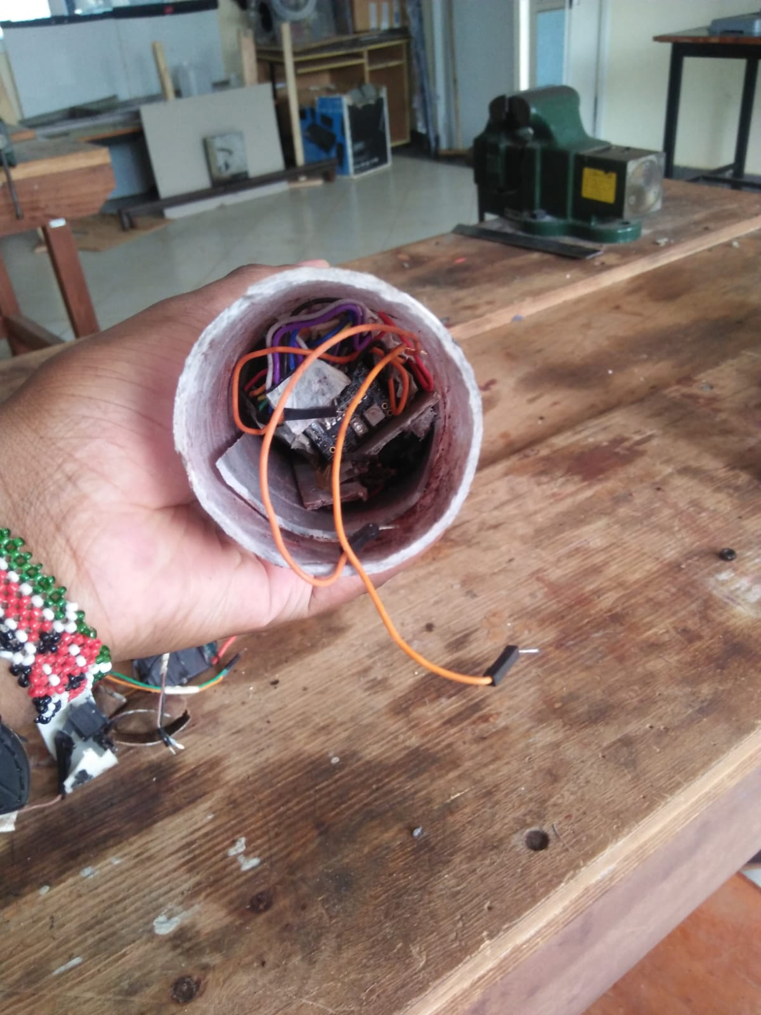
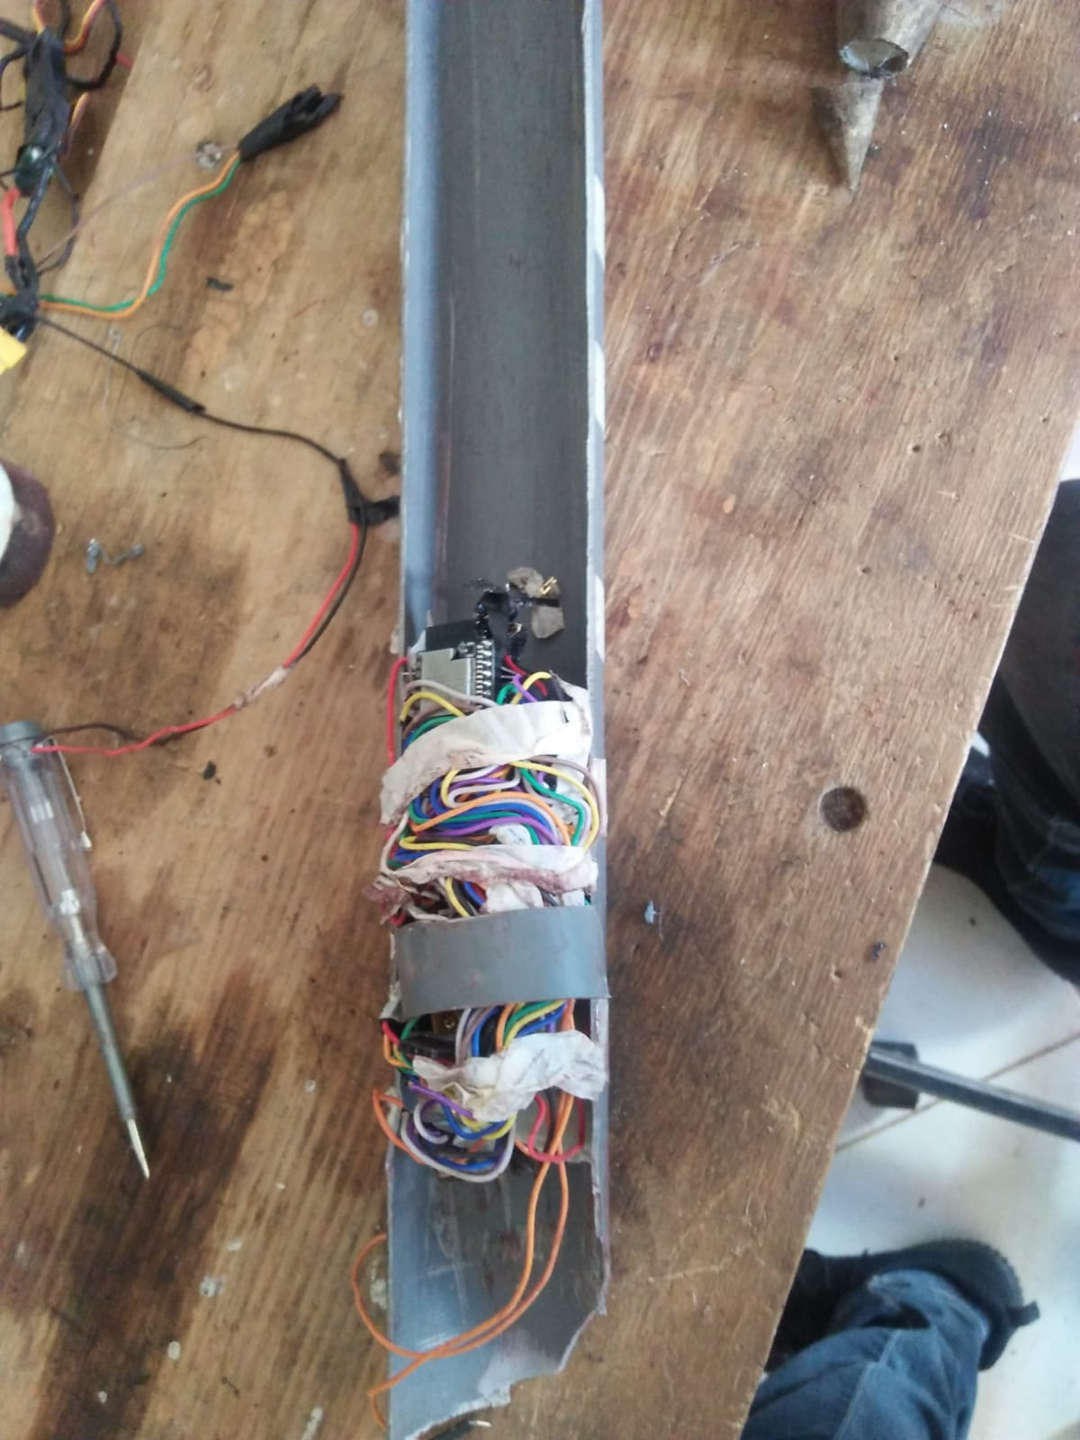

Slide 13
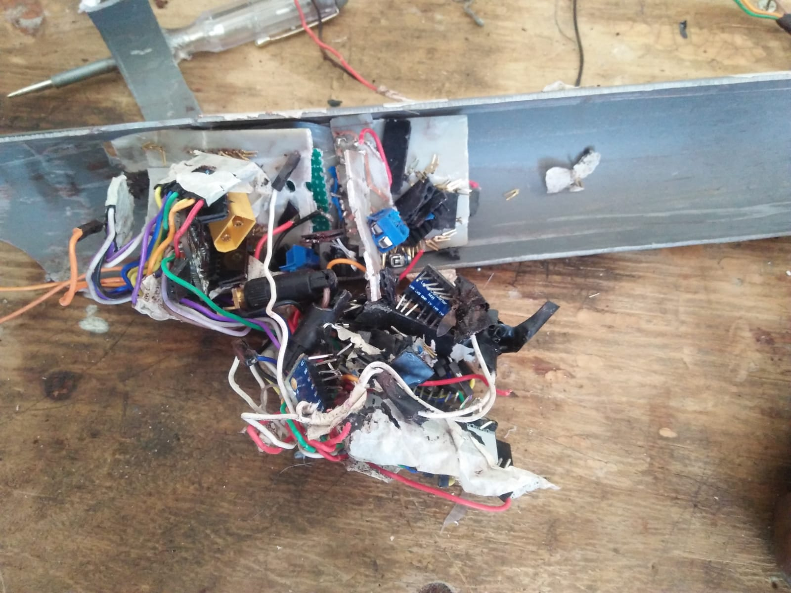
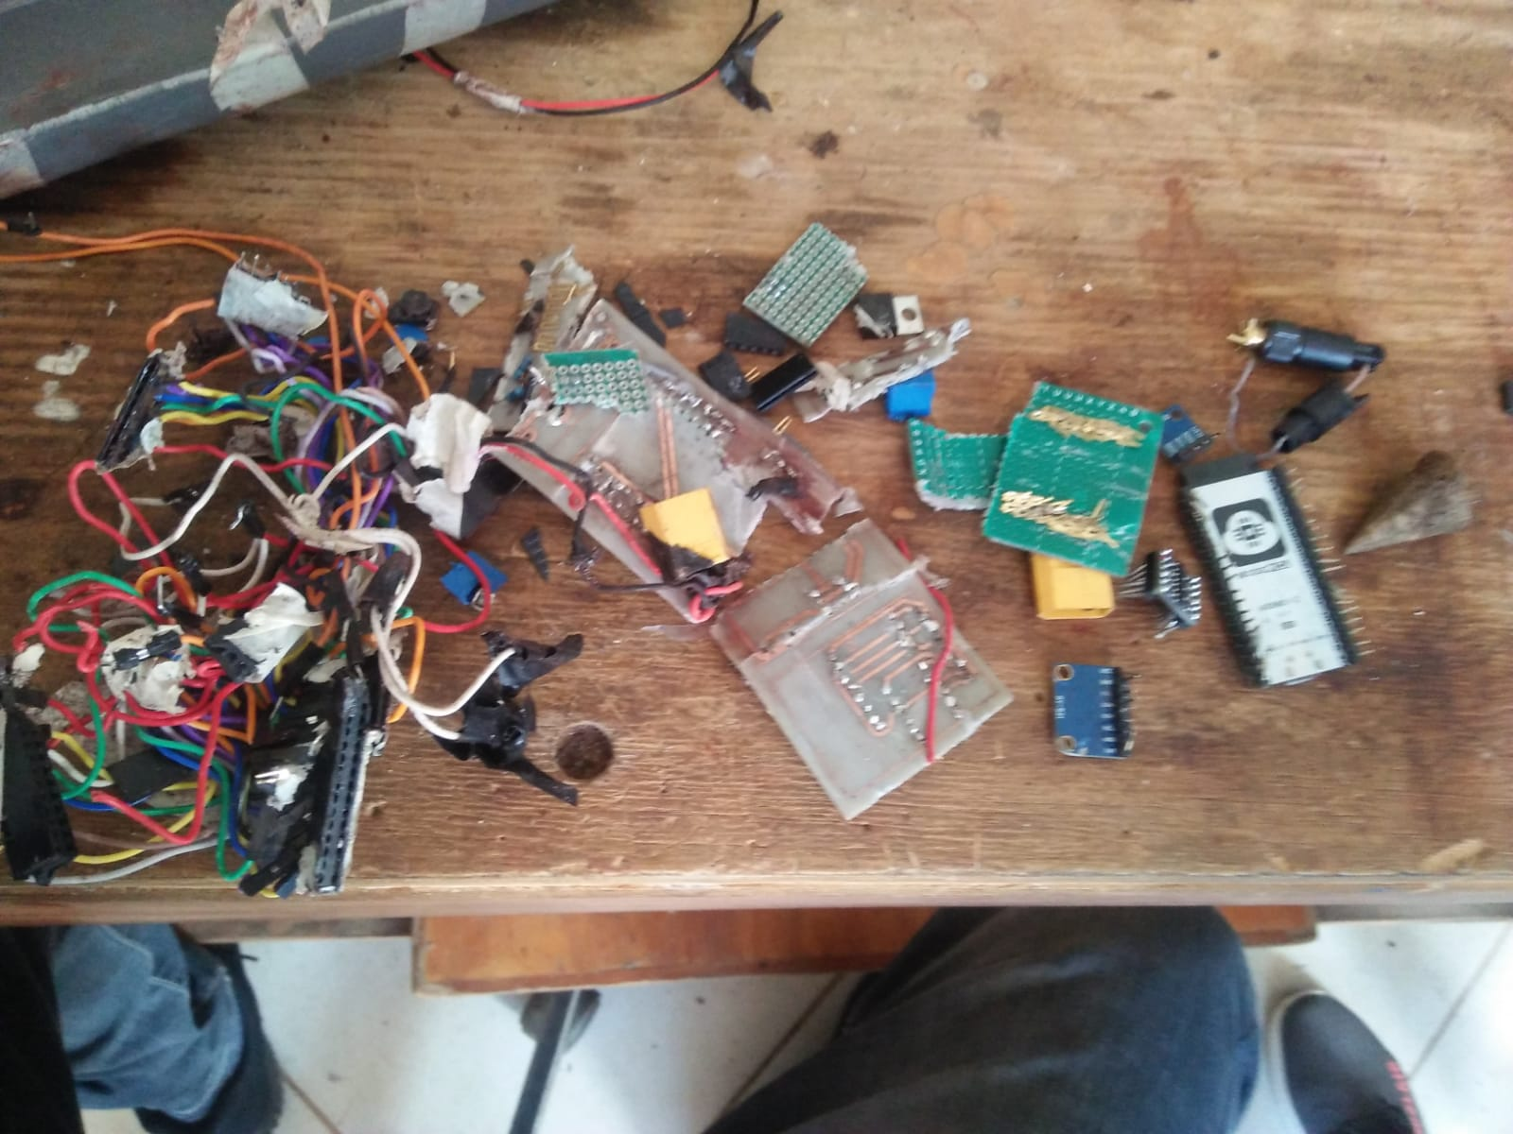

Slide 14
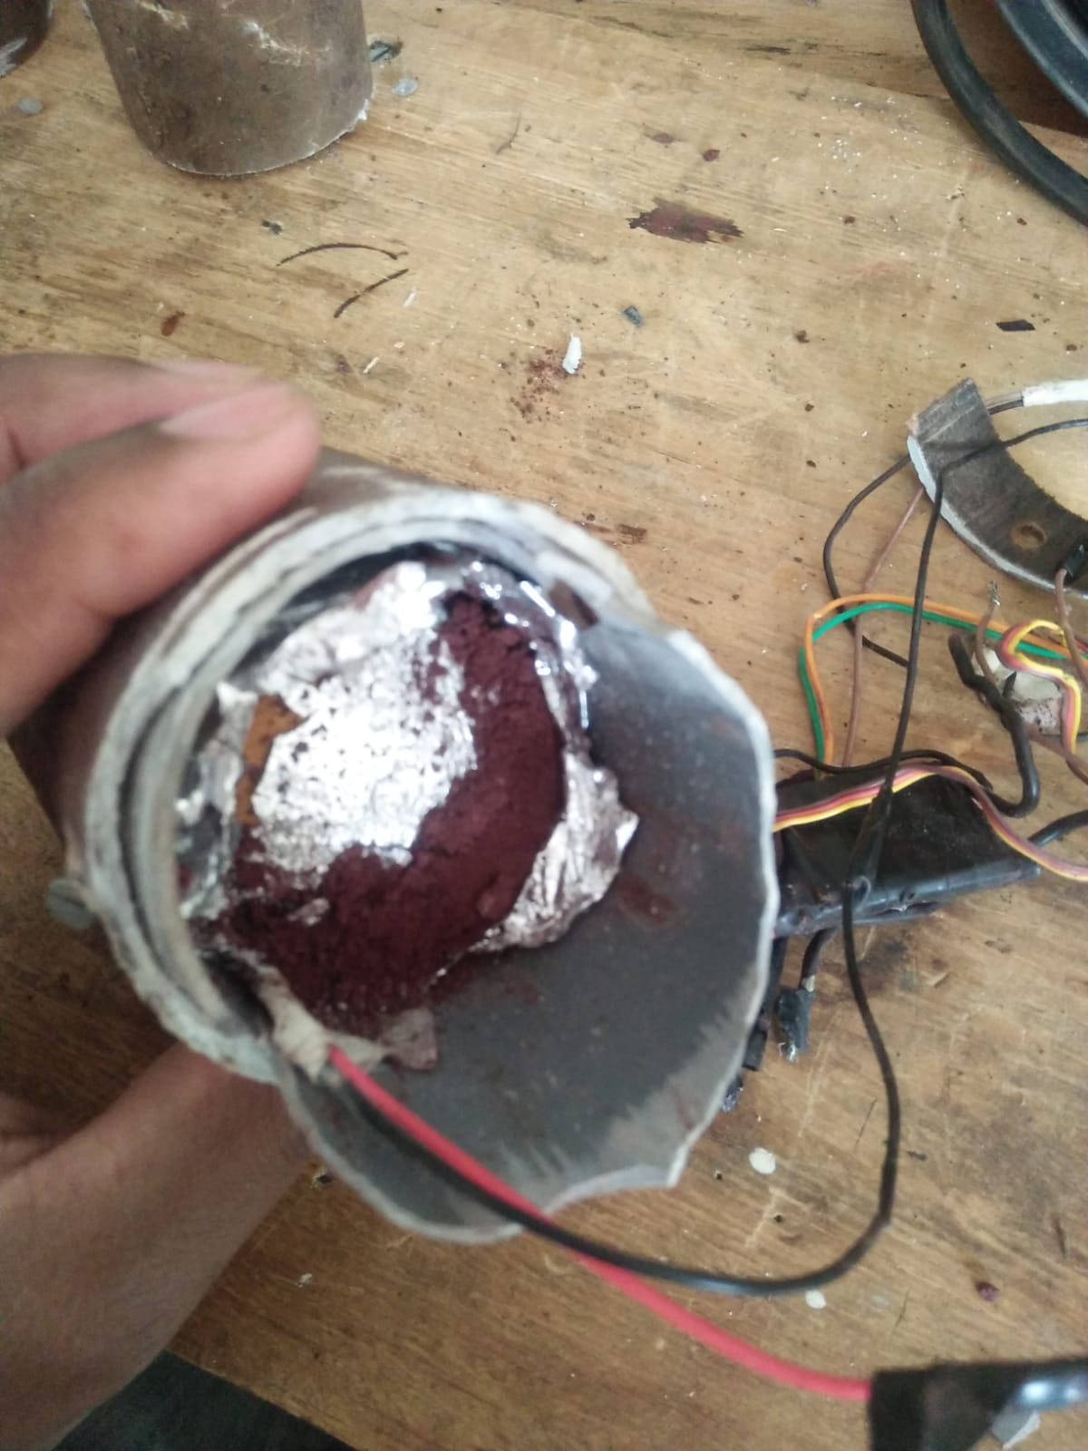
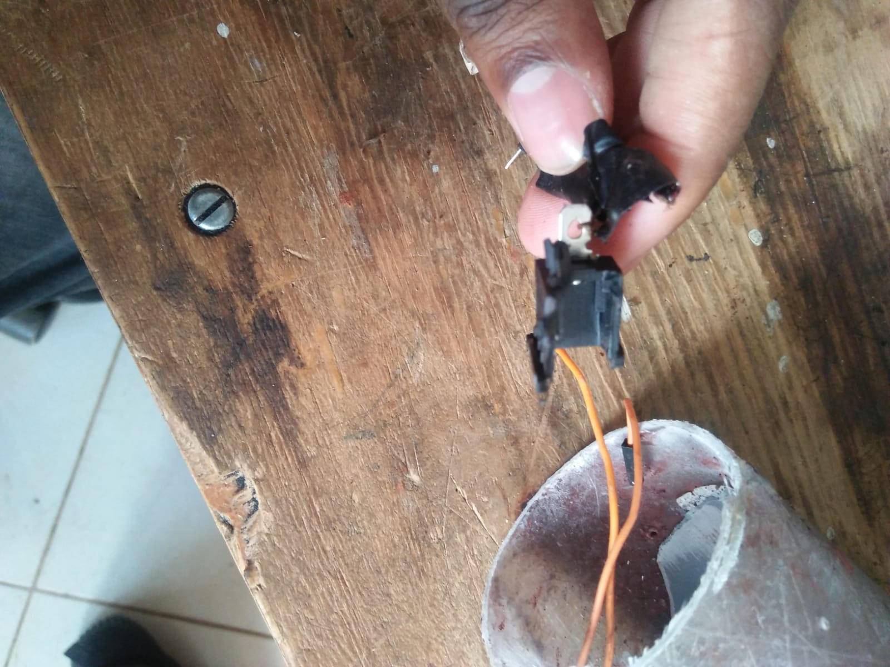
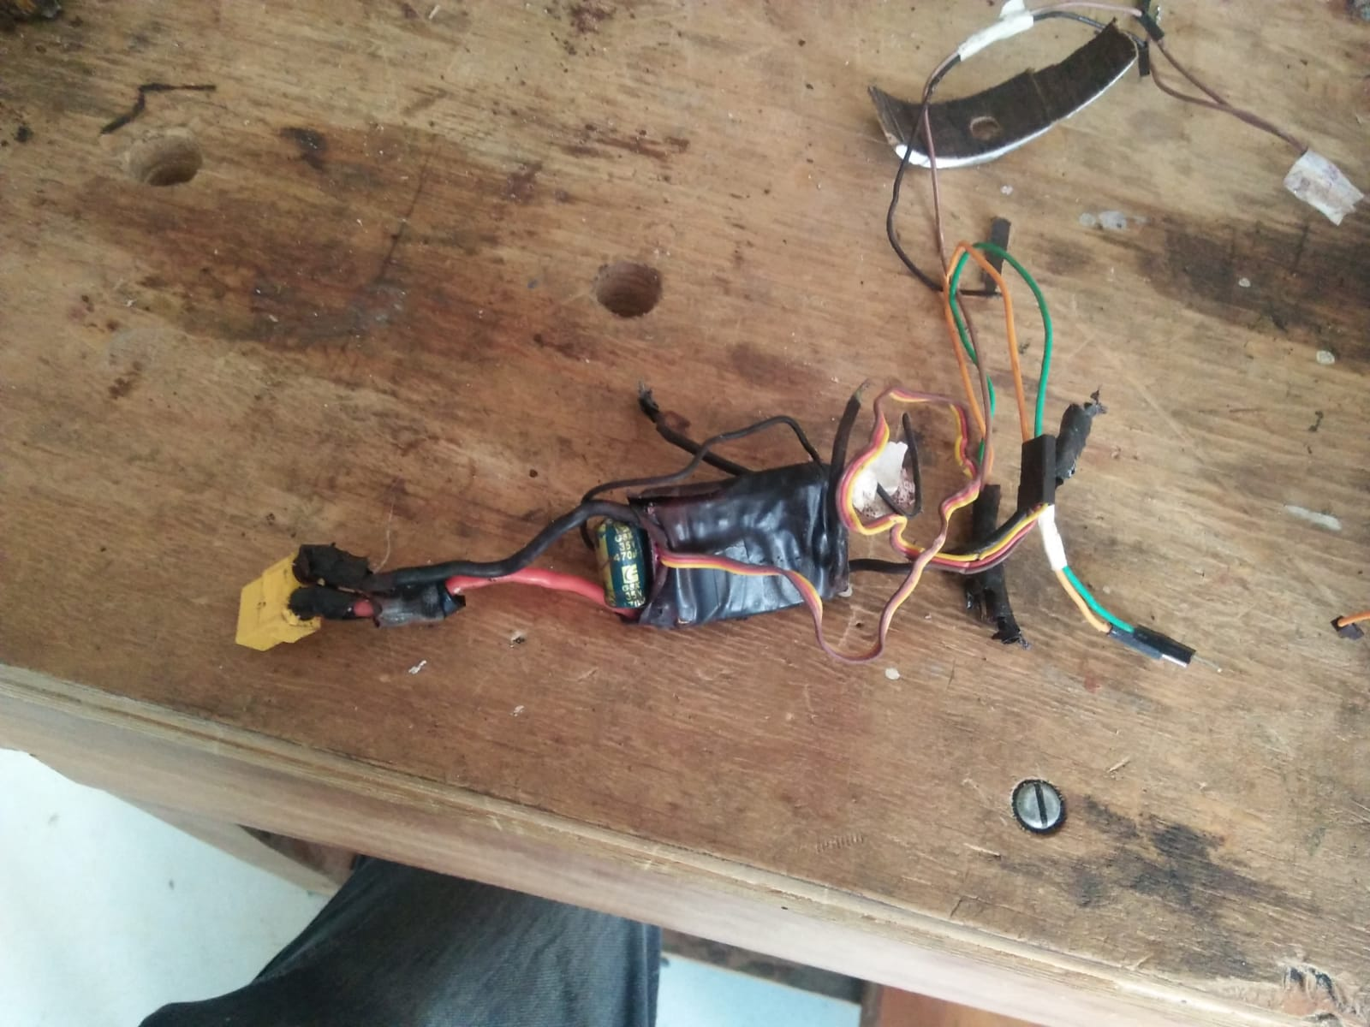

Slide 15
RTOS optimization
2 queues instead of 1
Reduced number of data points being sent over LoRa
LoRa - we are sending timestamp,altitude and state
SD card/SPI flash memory - timestamp, altitude, raw and
filtered gyro and acceleration values, state, gps latitude and
longitude

Slide 16
RTOS Queues

Slide 17
Ground station Manual Override
Rocket watches out for data packets from ground station
Update state to deploy parachute if it fails
Update ground state to start sending gps data

Slide 18
Write Data to SPI flash memory
ESP32 has 4MB non-volatile flash memory
Write to flash memory incase SD card fails like in test flight

Slide 19
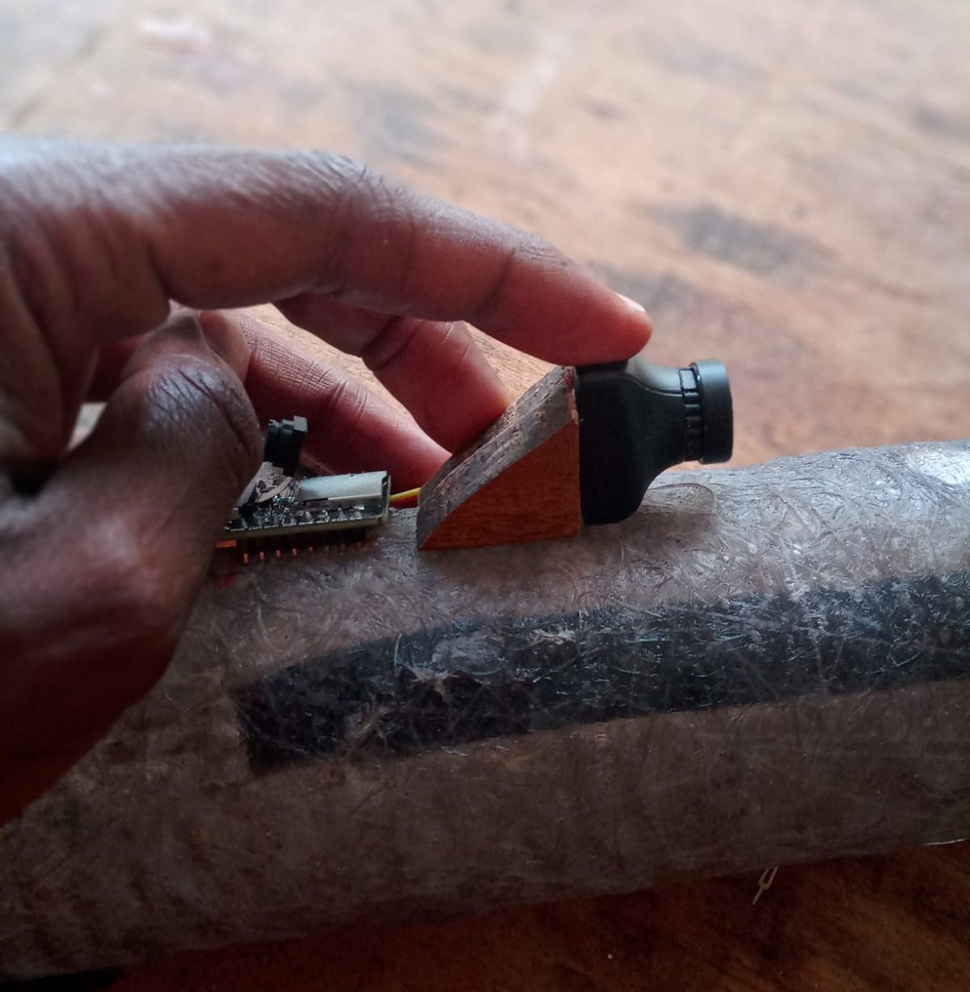
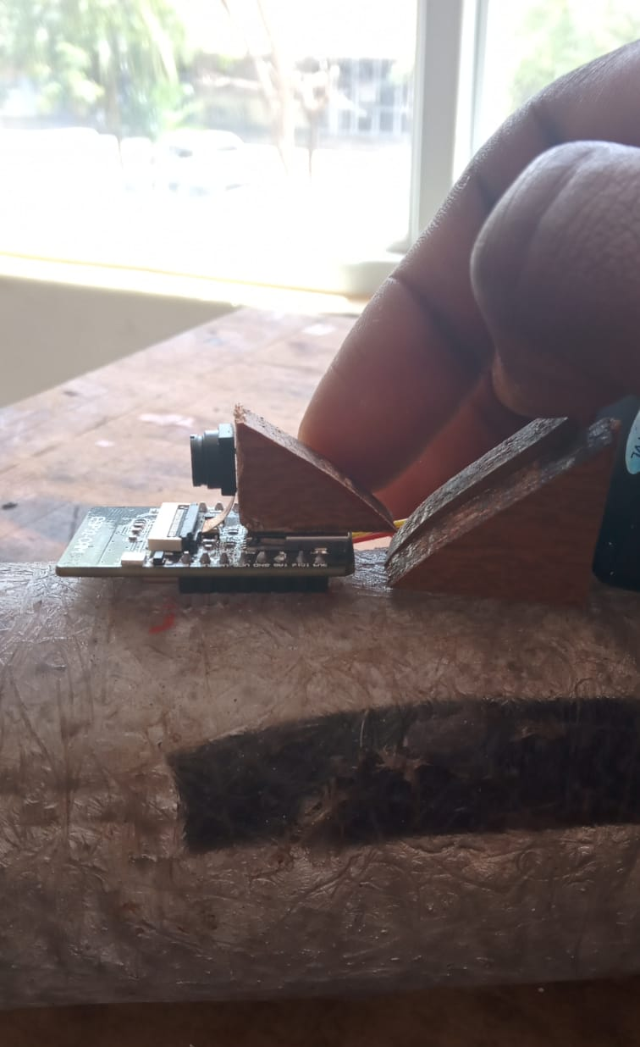
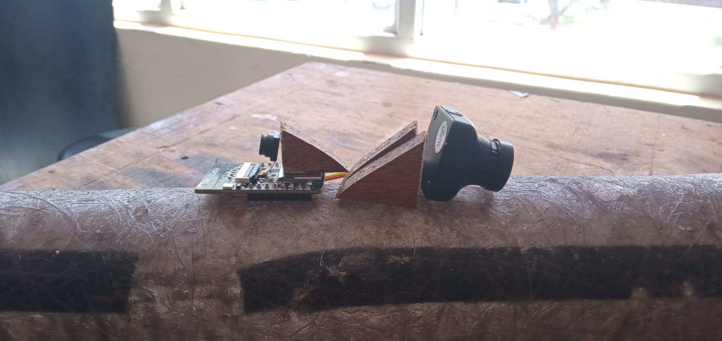
Camera mounting on the body tube

Slide 20
Purchase of a 2.4GHZ antenna
I recommend purchasing of an external wifi antenna for use for the flight launch.
The suggestion below has a long range and would be suitable as a receiving antenna.

Slide 21
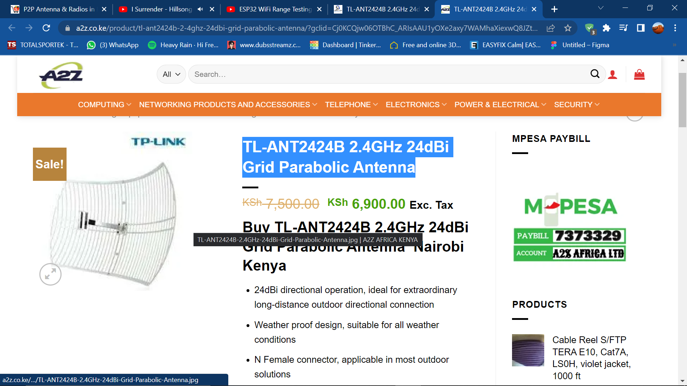
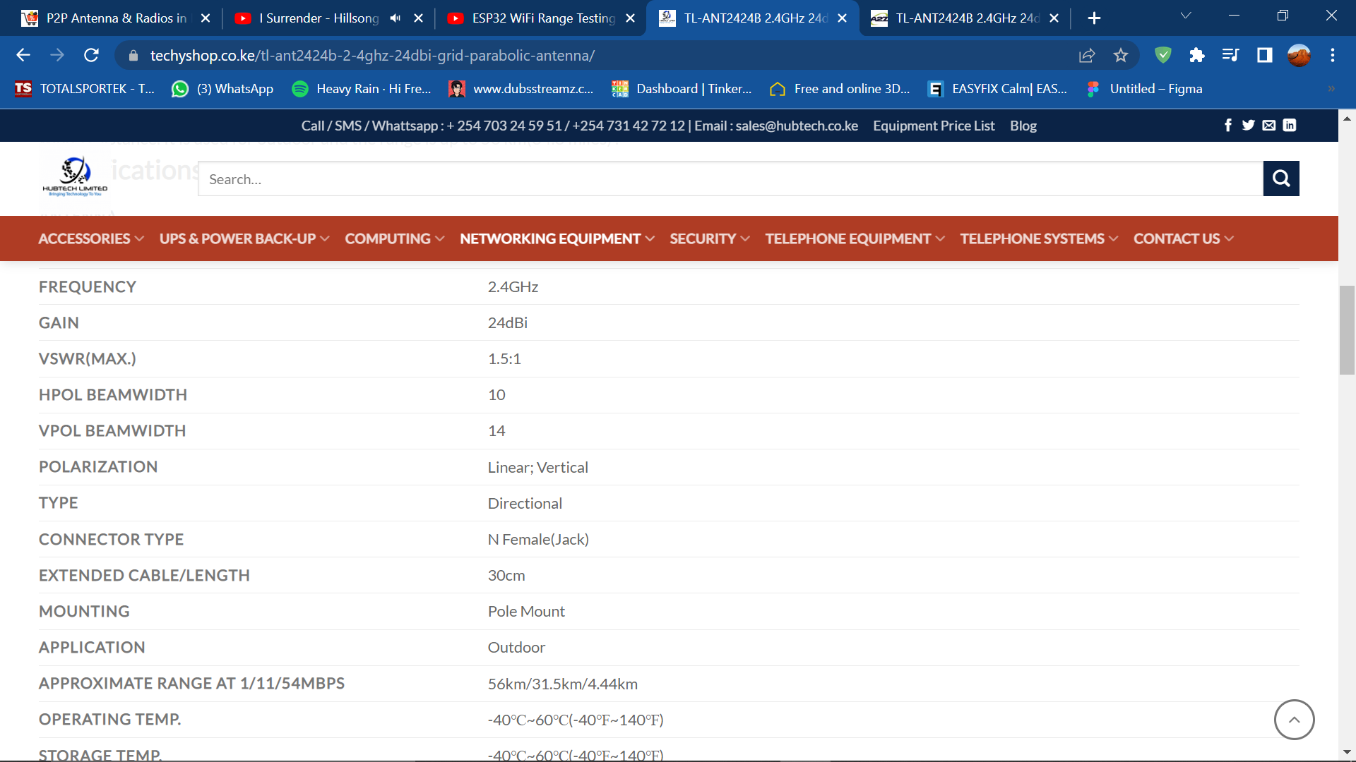
TP-LINK 2.4GHz parabolic ANTENNA

Slide 22
TASKs this week
Improvement of the check State code
Improvement of the parachute ejection system in conjunction with the airframe team
Design and fabrication of a new PCB for avionics and flight control
Test of the various components functionalities.
Issue #160 : Test GPS inside fibre glass body tube
Test software on breadboard

